Slide 1


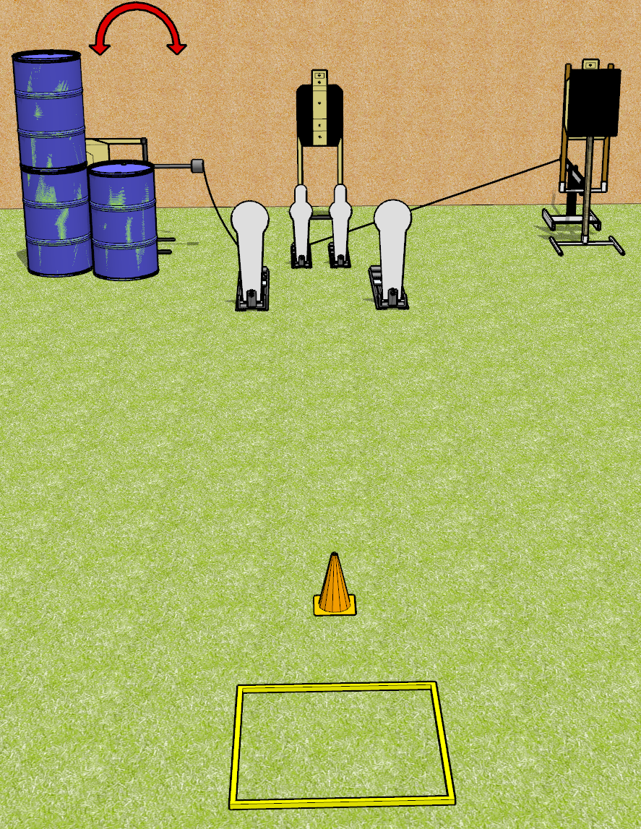
 | Dothan Gun Club – USPSA Match Now That’s Spicy Course Designer : Drew Coleman
Round Count 13 rounds 3 USPSA targets 2 colt poppers, 2 mini poppers
Equipment List Shooting box Swinger + activator Bobber + activator + steel 18x24 plate and stand 1 tuxedo

Slide 2
Now That’s Spicy
Written Stage Briefing
Now That’s Spicy is a 13 round, 65 point, Comstock speed shoot. There are 3 USPSA targets, 2 colt poppers, and 2 mini poppers. The best 3 hits on paper will score, and steel must fall to score. The start signal is audible.
The bobber is activated by either mini popper. The swinger is activated by the left colt popper. Please check the activators prior to walkthrough and set them the same way every time.
Handgun start position is in the shooting box, wrists below belt. Handgun is loaded and holstered.
PCC start position is in the shooting box, muzzle pointed at cone. Loaded carbine is held with both hands, safety on.
On start signal, engage any 2 poppers, perform a mandatory reload, and engage the remaining poppers. The paper targets may be engaged at any time in any order. Engaging more than 2 poppers without reloading will be a single procedural per popper engaged.

